Slide 1
CORC-11586 Lambda Token Generator | Enable TFVar Migration for Dev, INT

Slide 2
Purpose:
-we want to achieve single environment deployment pipelines for all existing environments. Because with this we want to migrate Legacy environment deployments to Pushbutton Environment Deployments.
-with this Standardized Environments will enable us to achieve faster releases as PushButton Environments by removing Terraform configuration file.
Notes:
Adjust logo

Slide 3
Steps to achieve to solve:
Materialized the configuration files
Done with some Manual changes
- Done with Backward Compatibility
Notes:
Adjust logo

Slide 4
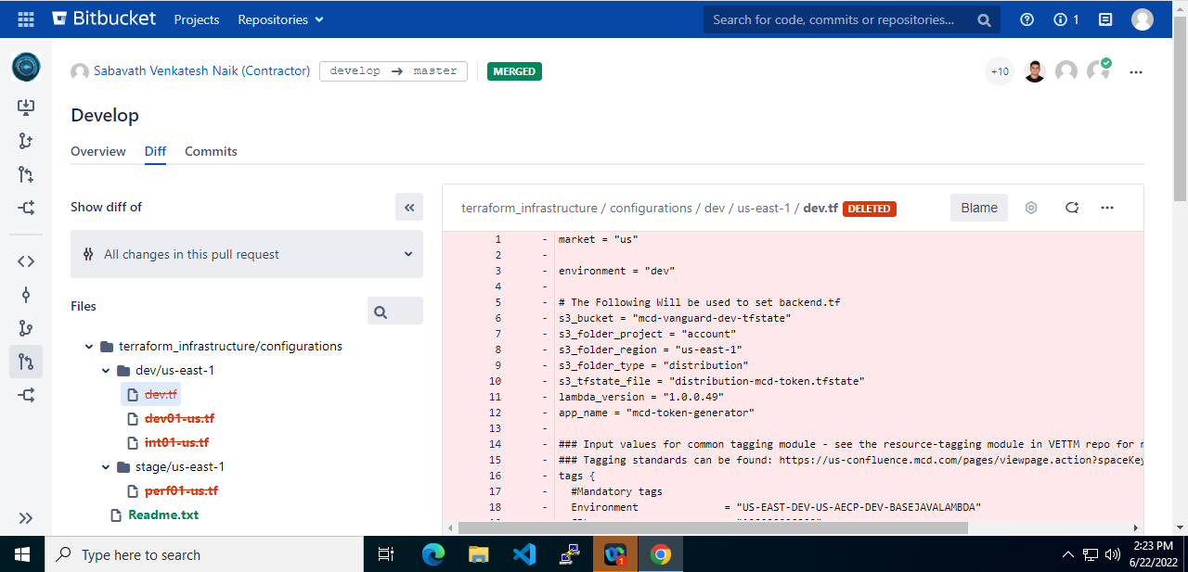

Removed TF Files from Infrastructure repo:

Slide 5
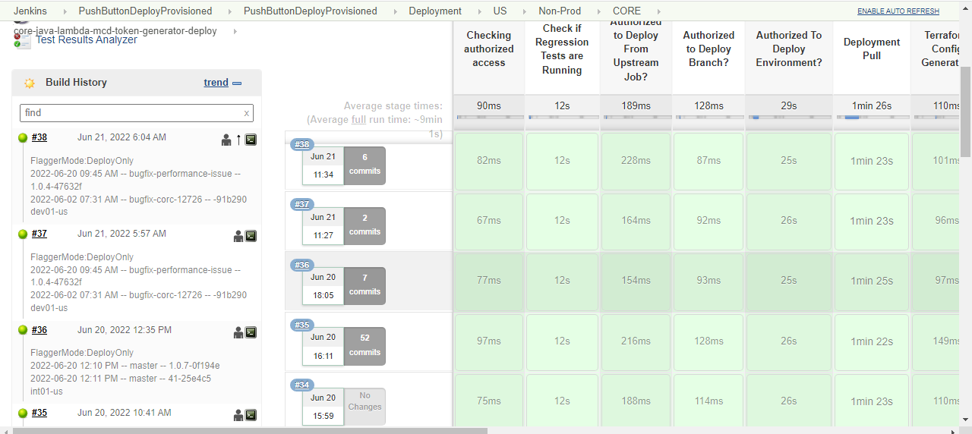
PushButton Deployment:

Slide 6
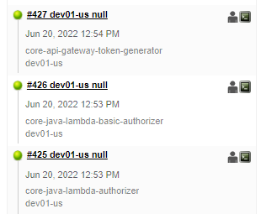
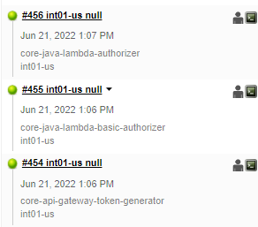
Testing details on DEV,INT:

Slide 7



